Slide 1
Tutorial 6 CSI3130-Database II
Vikas Gogia
(vgogi074@uottawa.ca)

Slide 2
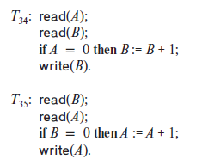
18.2
Consider the following two transactions:
Add lock and unlock instructions to transactions T31 and T32 so that they observe
the two-phase locking protocol. Can the execution of these transactions
result in a deadlock?

Slide 3
(c) 2-phase locking protocol: In general it’s a protocol that states unlocking is followed by locking phase. More simply, first unlocking in a transaction signifies all locks will be unlocked and no locking is allowed in that phase i.e. Locking happens first and then unlocking for all.
T₃₄ Lock-S(A): read(A) Lock-X(B): if A=0 then B:=B+1 write(B) Unlock(A) Unlock(B)

Slide 4
Similarly for T35
Lock-S(B): read(B) Lock-X(A): if B=0 then A:=A+1 write(A) Unlock(B) Unlock(A)

Slide 5
Execution of these can lead to a deadlock as follows:
Here, T34 tries to acquire B which is possessed by T35 and in the same way T35 tries to get a hold of A which is held by T34. It creates a deadlock situation
T34 Lock-S(A) read(A) Lock-X(B) | T35 Lock-S(B) read(B) Lock-X(A)

Slide 6
18.19
Consider a variant of the tree protocol called the forest protocol. The database is organized as a forest of rooted trees. Each transaction T_{i} must follow the following rules:
• The first lock in each tree may be on any data item.
• The second, and all subsequent, locks in a tree may be requested only if the parent of the requested node is currently locked.
• Data items may be unlocked at any time.
• A data item may not be relocked by T_{i} after it has been unlocked by T_{i} . Note: Read and write both are allowed in forest protocol
Show that the forest protocol does not ensure serializability

Slide 7
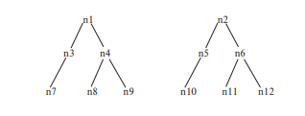

Slide 8
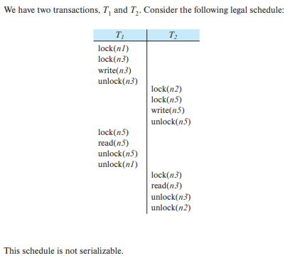
Write-read conflict i.e. non-conflict serializable

Slide 9
18.25
Suppose the lock hierarchy for a database consists of database, relations, and tuples.
If a transaction needs to read a lot of tuples from a relation r, what locks should it acquire?
Now suppose the transaction wants to update a few of the tuples in r after reading a lot of tuples. What locks should it acquire?
If at run-time the transaction finds that it needs to actually update a very large number of tuples (after acquiring locks assuming only a few tuples would be updated). What problems would this cause to the lock table, and what could the database do to avoid the problem

Slide 10
(a)
Main Action: Read (a lot of tuples)
Lock Hierarchy:
IS (shared intent) lock on DB
S (shared) lock on relation r
Shared intent lock prevents another transaction to acquire X lock on the table.

Slide 11
(b)
Main Action: Write (a lot of tuples)
Lock Hierarchy:
IX (exclusive intent) lock on DB
SIX (shared and intention exclusive) lock on relation r
X on required tuples

Slide 12
(c)
At run time, lock table in memory would get full due to large number of blocks. In order to avoid this, upgrade lock from SIX to X on the relation r. Thus, the individual X locks are escalated to relation level X lock.

